Slide 1

IMPACT OF CAR FEATURES ON PRICE AND PROFITABILITY
By Sudhansu

Slide 2
AGENDA
Project Description
Approach
Tech-Stack Used
Insights
Result
Python Jupyter Notebook hyperlink :
Jupyter Notebook as .ipynb
Tableau workbook for visualisations & dashboard hyperlink:
tableau workbook .twb
link for : tableau workbook as pdf
Link for: Juypyter notebook as pdf

Slide 3
Project Description
The automotive industry has been rapidly evolving over the past few decades with increasing competition among manufacturers and a changing consumer landscape. So, Clients need price optimization & product development decisions to maximize profitability while meeting consumer demand.
The dataset contains information on various car models and their specifications, and is titled "Car Features and MSRP". It was collected and made available on Kaggle by Cooper Union, a private college located in New York City
The dataset contains information on over 11,000 car models and their specifications, including details on the car's make, model, year, fuel type, engine power, transmission, wheels, number of doors, market category, size, style, estimated miles per gallon, popularity, and manufacturer's suggested retail price (MSRP).
Using this dataset to gain insights into various aspects of the automotive industry

Slide 4
Approach
Downloaded and imported the dataset in Jupyter Notebook, performed data cleaning i.e. removing missing & invalid rows and handling outliers. Used Tableau a visualisation tool to draw graphs and finding insights. And finally drawn conclusions from insights and made recommendations
Tech-Stack Used
Software: Python 3.10.12, Tableau Desktop 2023.1.0
Version: Jupyter Notebook 6.4.6
Purpose: Data cleaning and visualization
I used Jupyter Notebook and Tableau to clean and visualize data because these tools are powerful and versatile. Python is a general-purpose programming language that can be used for a variety of tasks, including data cleaning and visualization. Jupyter Notebook is an interactive environment that makes it easy to write and run Python code.

Slide 5
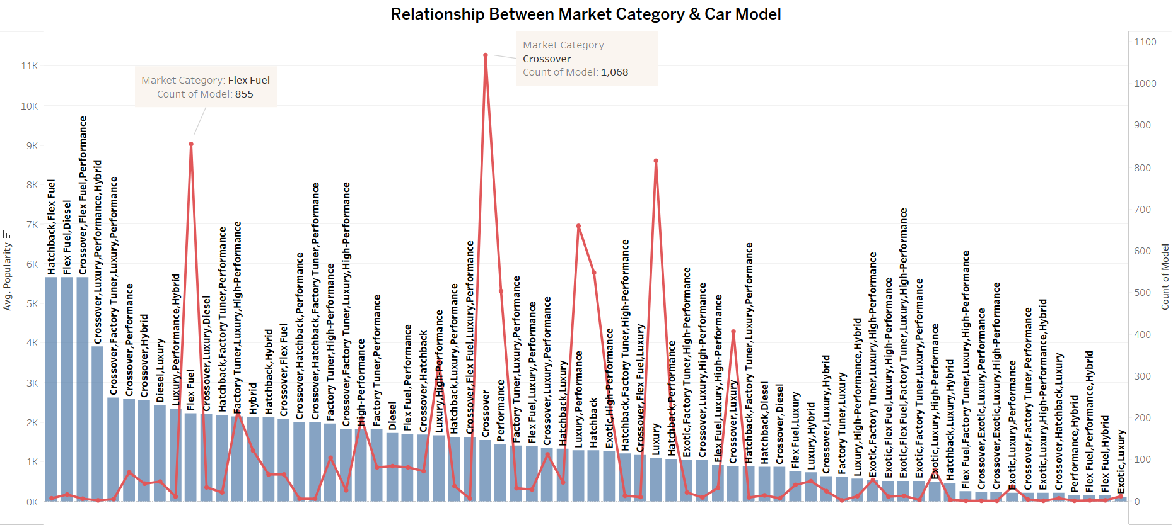
Insights: Hatchback, Flex Fuel & Diesel is the most popular market category, Crossover & Flex Fuel has the most no. of car models

Slide 6
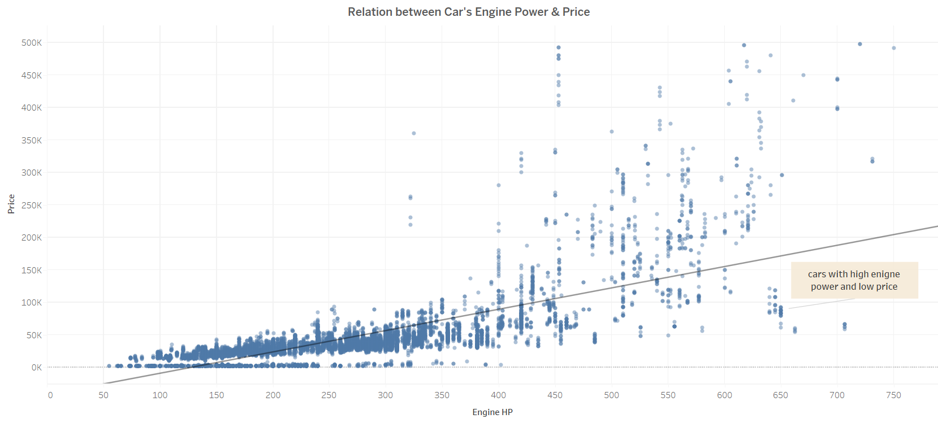
There is a strong positive correlation between Car’s Engine Power & Price, Some cars with high engine power and low price are also present

Slide 7
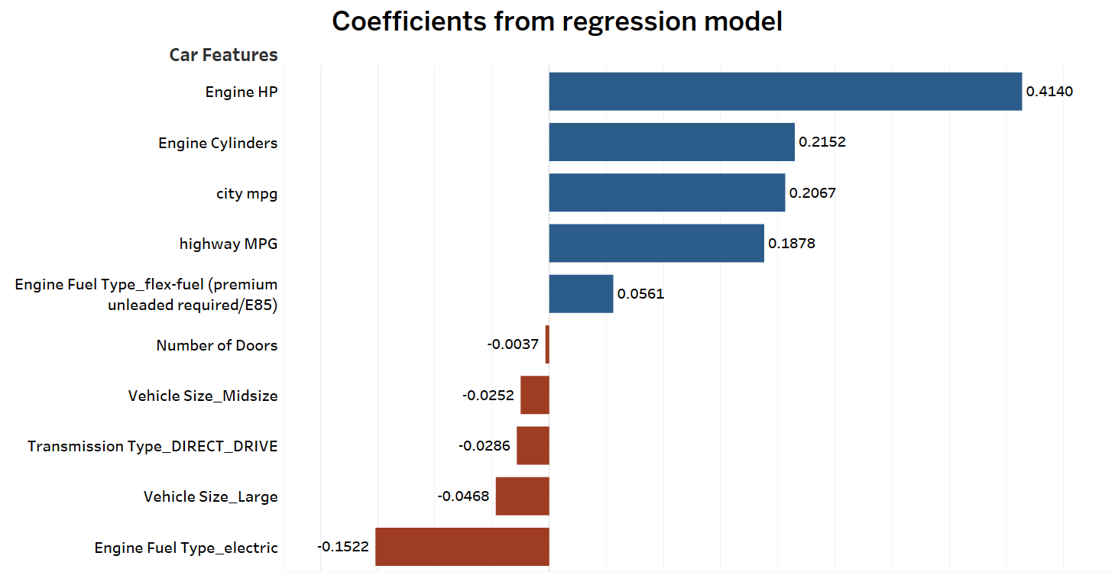
Engine HP & Engine Cylinders have the strongest relationship with car’s price, the most important features in determining the car’s price

Slide 8
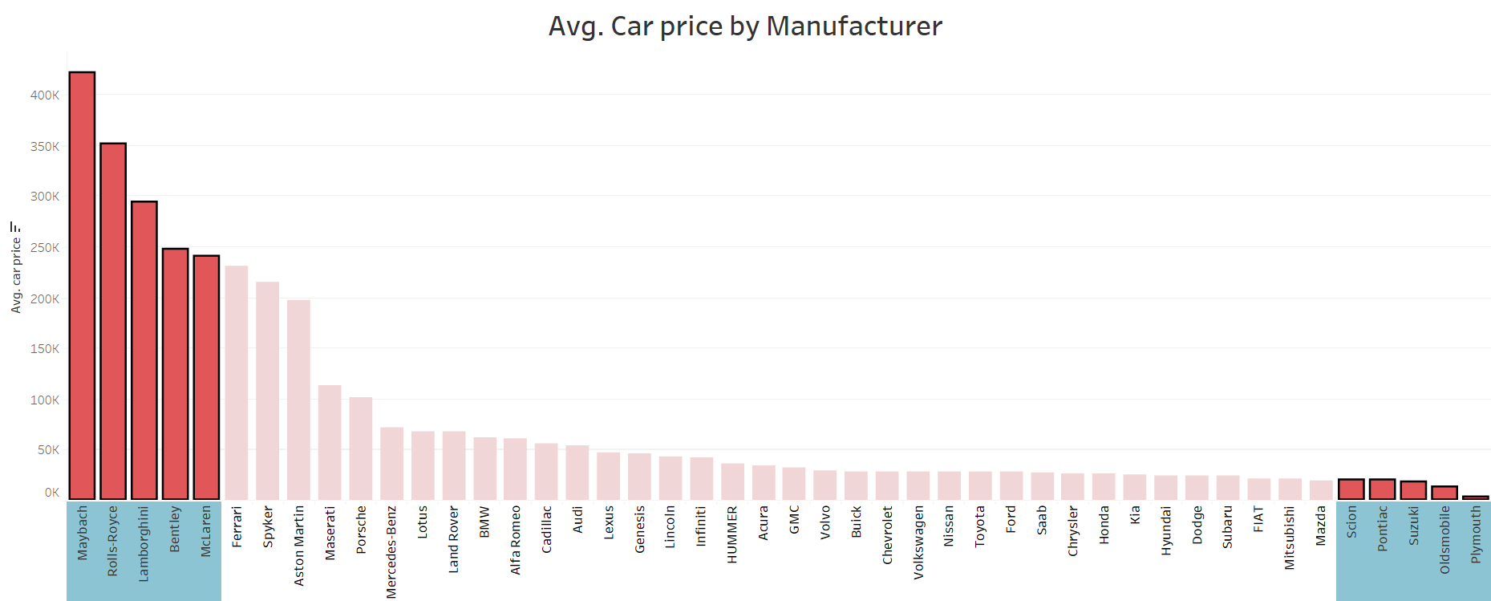
Maybach, Rolls-Royce, Lamborghini are the competitor brands for high budget cars and Plymouth, Oldsmobile, Suzuki for low budget cars
NOTE : very expensive brands like Bugatti are removed from the data which can distort our analysis

Slide 9
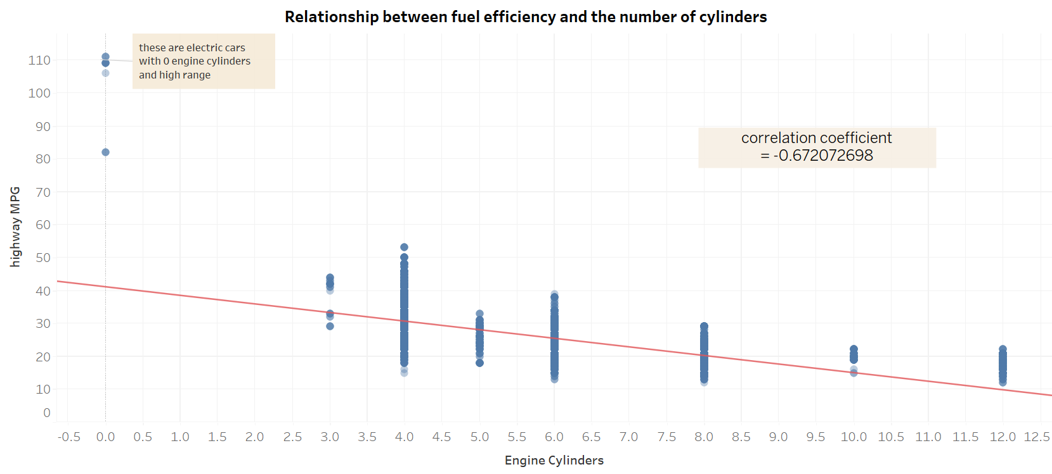
There is a strong negative correlation between no. of Engine cylinders and MPG

Slide 10
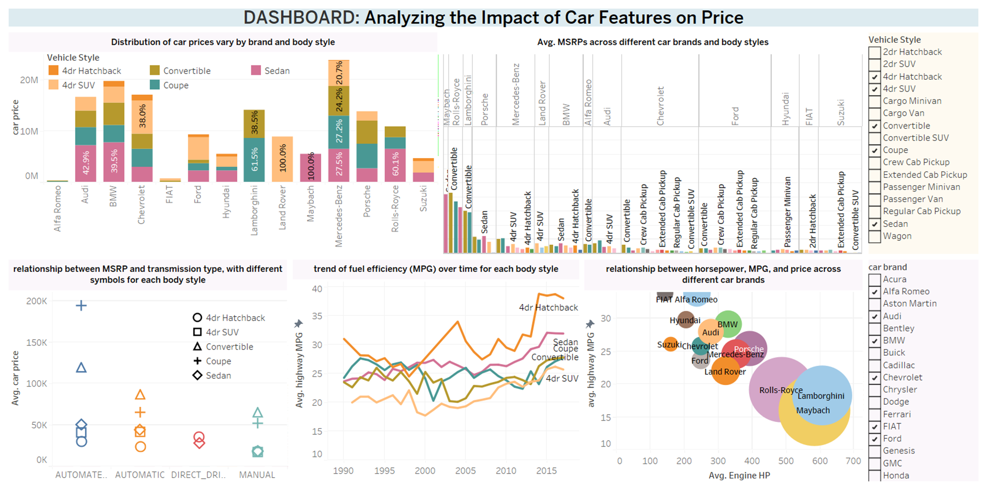

Slide 11
Results
Conclusions and recommendations :
Cars with 200 HP engine or below are priced below $50k, 500-600 HP cars are around $100k and can go above also. Company should optimize price accordingly
Engine power and cylinder are most important feature in determining car’s price
Cars with automated_manual and automatic transmission type are high priced
There is a trade off between engine power and efficiency, more HP engine results in lower efficiency and high price
Hatchback, Flex Fuel & Diesel and crossover market category is in high demand among people
Trend of fuel efficient 4dr Hatchback and Sedan has grown over the years

Slide 12
Thank you

